Slide 1
Chapter 4: Intermediate SQL
Notes:
In this chapter, we continue our study of SQL. We will learn different types of joins, views, integrity constraints, and more details regarding SQL data definition in this chapter. So let’s begin.

Slide 2

Joined Relations
Join operations take two relations and return as a result another relation.
These additional operations are typically used as subquery expressions in the from clause
Join condition – defines which tuples in the two relations match, and what attributes are present in the result of the join.
Join type – defines how tuples in each relation that do not match any tuple in the other relation (based on the join condition) are treated.
Notes:
We looked at how to join 2 or more tables in the previous chapter. In particular, we looked at a natural join and a join over 2 tables using cartesian product based on a common attribute. The joins we looked at till now are called an inner join. In an inner join, only the tuples that match from BOTH relations are presented in the result. Now we will look at more scenarios.

Slide 3



Join operations – Example
course
prereq
Return all information of all courses including their prerequisites
There are no prerequisites for CS-315
An inner join between course and prereq would create this result:
Notes:
Let us consider these 2 tables that have information on courses and the prerequisites for each course. Suppose we want to know the information of all courses including their prerequisites. Note that, in this data, there are no prerequisites for CS-315, and hence it does not exist in the prereq table. If we were to do an inner join between these two tables, then we will lose information about CS-315 because only matching tuples are returned.

Slide 4
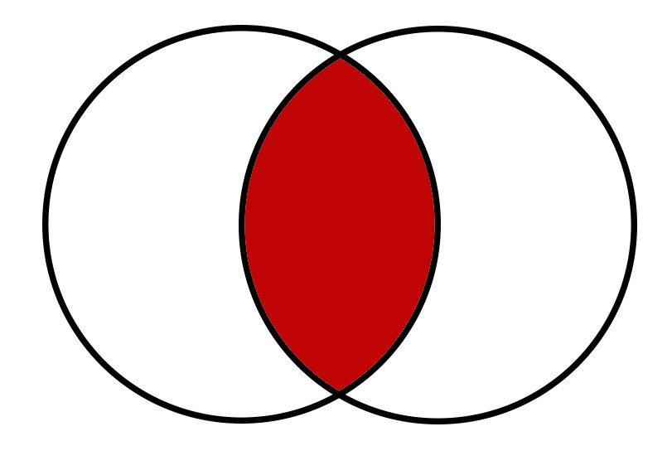
Join operations – Example
course
prereq
An inner join can be represented by the following Venn Diagram:
course
prereq
Notes:
An inner join can be represented by the following Venn Diagram. Only matching tuples are returned in the results.
To avoid loss of important information, SQL also provides joins called outer joins that lets us return information from non-matching tuples as well.

Slide 5
Outer Join
An extension of the join operation that avoids loss of information.
Computes the join and then adds tuples from one relation that does not match tuples in the other relation to the result of the join.
Uses null values.
Notes:
In outer joins, tuples that do not match are also returned. Outer joins use null values to fill the cell values for which information does not exist. Let us look at some examples in the next slides to understand it better.

Slide 6
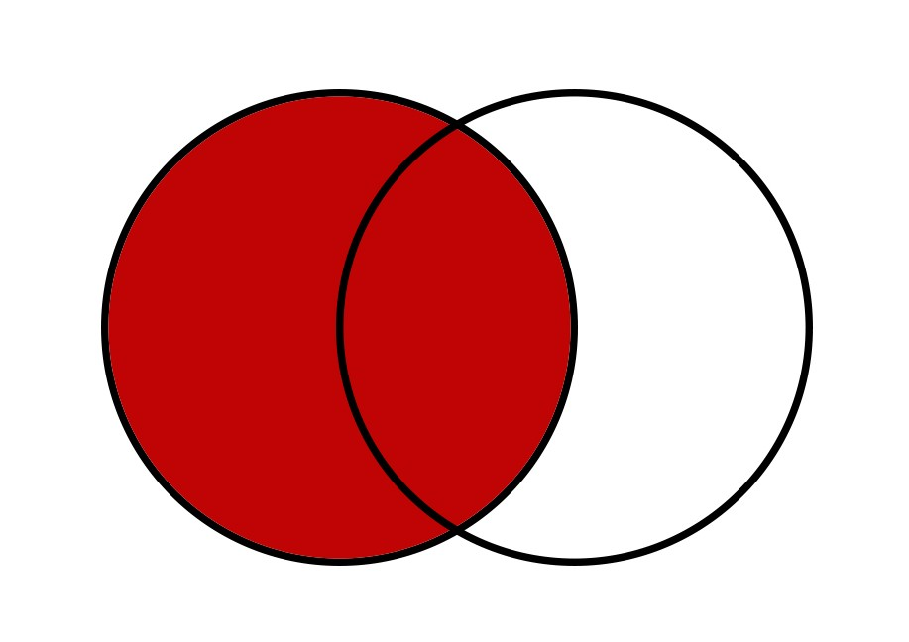

Left Outer Join
The left outer join preserves tuples only in the relation named before (to the left of) the left outer join operation
  course left outer join prereq
course
prereq
Notes:
The left outer join preserves tuples from the relation named before the left outer join operation. In this example, course is before the left outer join operation. Hence all tuples from the course relation exist in the result set. Note that, CS-347 exists in the prereq table, but not in the course table. Hence it does not appear in the result set.
Since CS-315 only exists in the course table and not in the prereq table, there is no prerequisite information on CS-315. Hence, we use the null value for the prereqID column for CS-315. I hope this Venn diagram makes your understanding clearer.

Slide 7
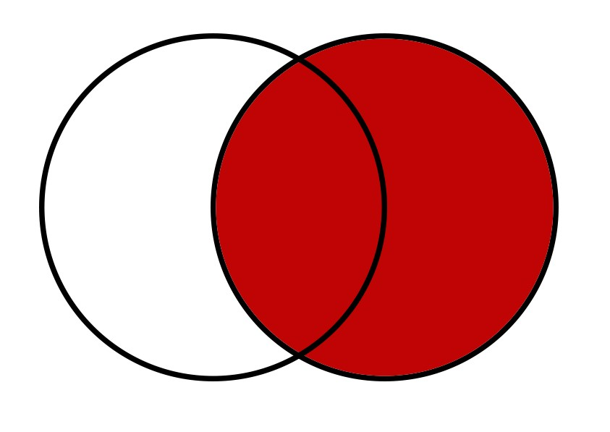

Right Outer Join
The right outer join preserves tuples only in the relation named before (to the right of) the right outer join operation
  course right outer join prereq
course
prereq
Notes:
Similarly, the right outer join preserves tuples from the relation named after the right outer join operation. Hence, in this example, all tuples from the prereq relation exist in the result set. CS-347 exists in the result, whereas CS-315 which only exists in the course table is not in the result set.

Slide 8
Left Outer Join vs Right Outer Join
course left outer join prereq is the same as
prereq right outer join course
course
prereq
is the same as
prereq
course
Notes:
Note that the left outer joins and right outer joins can be interchanged if the tables are also interchanged.
Course left outer join prereq will give the same result as prereq right outer join course. In both cases, all tuples from the course table will be included in the result set.
Hence, most databases only support left outer joins.

Slide 9
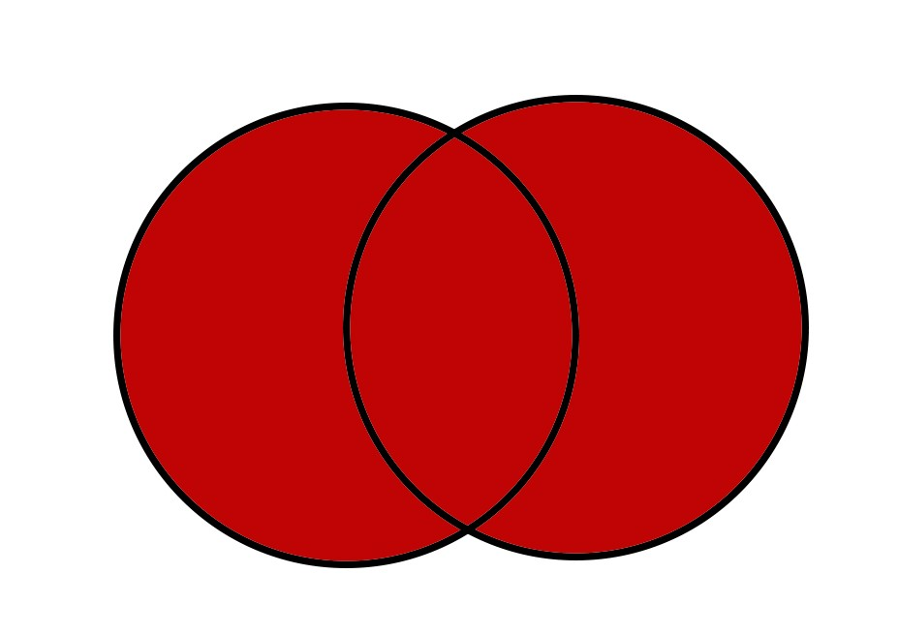

Full Outer Join
The full outer join preserves tuples in both relations
  course full outer join prereq
course
prereq
Notes:
And a full outer join preserves tuples from both relations. In this case, both CS-315 and CS-347 are in the result set. For information that does not exist after a join, null values are used. Note that a full outer join is not the same as the cartesian product. A cartesian product joins each row from the course table with each row from the prereq table.
On the other hand, the full outer join will join on the course_ID in this case and only present the relevant information by preserving tuples from both relations.

Slide 10
Views
In some cases, it is not desirable for all users to see the entire logical model (that is, all the actual relations stored in the database.)
Consider a person who needs to know an instructors name and department, but not the salary. This person should see a relation described, in SQL, by
select ID, name, dept_name
from instructor
A view provides a mechanism to hide certain data from the view of certain users.
Any relation that is not of the conceptual model but is made visible to a user as a “virtual relation” is called a view.
Notes:
Now, we will look at views. Consider the example of the provost of the university that we looked at earlier. We want the provost to be able to view everyone’s salaries in the university, but we do not want instructors to view other instructor’s salaries. An instructor should be able to view only their salary, not anybody else’s.
One naïve way would be to create a separate table with the appropriate data for everyone. The problem with this approach is obviously the amount of space required to store redundant data. Instead of physically storing different data for different users, SQL lets you create virtual relations for different users, which are called views.

Slide 11
View Definition
A view is defined using the create view statement which has the form
create view v as < query expression >
where <query expression> is any legal SQL expression. The view name is represented by v.
Once a view is defined, the view name can be used to refer to the virtual relation that the view generates.
View definition is not the same as creating a new relation by evaluating the query expression
  Rather, a view definition causes the saving of an expression; the expression is substituted into queries using the view.
Notes:
A view provides a mechanism to hide certain data from the view of certain users.
The above is the syntax for creating a view. Try the following in your SQL database: before any SQL query, write the words create view V as, and it will store the results of your SQL query in a view named V.
Note that the view stores virtual relations. We are not physically copying the data again for each view. Instead, in views, we are storing pointers to the actual data.

Slide 12
Views (contd.)
A view of instructors without their salary
create view faculty as
select I.ID, I.name, I.dept_name
from instructor I;
Find all instructors in the Biology department
select name
from faculty
where dept_name = ‘Biology’;
Create a view of department salary totals
create view departments_total_salary(dept_name, total_salary) as
select dept_name, sum (salary)
from instructor
group by dept_name;
Notes:
The first query shows how to create a view of instructors without their salary. We only store the first 3 attributes of the instructor table into a view named faculty. For certain instructors, the database system can be designed such that they are only given access to faculty, thus preventing them from seeing other instructor’s salary.
The last query shows how you can also specify names of the columns of the view.

Slide 13
Views Defined Using Other Views
create view physics_fall_2009 as
select course.course_id, sec_id, building, room_number
from course, section
where course.course_id = section.course_id
and course.dept_name = ’Physics’
and section.semester = ’Fall’
and section.year = ’2009’;
create view physics_fall_2009_watson as
select course_id, room_number
from physics_fall_2009
where building= ’Watson’;
Notes:
This slide shows one more example of how to create a view and then reference it later.

Slide 14
Views Example I
Find the average instructors’ salaries of those departments where the average salary is greater than $42,000.”
Notes:
In the previous chapter, we solved this query using different ways: with a single SQL query that uses the group by and HAVING clause, or by using nested subqueries, or by using the WITH clause. Now, try solving this query by using a view.

Slide 15
Views Example I
Find the average instructors’ salaries of those departments where the average salary is greater than $42,000.”
create view avgSalaryDept (dept_name, avg_salary) as
select I.dept_name, avg (I.salary)
from instructor I
group by I.dept_name;
select *
from avgSalaryDept A
where A.avg_salary > 42000;
Notes:
This is one way to solve this query by using a view. You store the information about the departments and the average salaries of each department in a view. And then return only the departments with average salary greater than $42000 by using a filtering condition on the view.

Slide 16
Views Example I
Find the average instructors’ salaries of those departments where the average salary is greater than $42,000.”
Can also be written as:
create view finalResult as
select I.dept_name, avg (I.salary)
from instructor I
group by I.dept_name
having avg (I.salary) > 42000;
  select *
  from finalResult;
Notes:
When I taught this class in Fall 2017 for the first time, I asked this question on the exam where students could only use views to solve this query. And this is the answer that one student wrote. For the question I asked, this is technically right. I learned my lesson and have tried my best to stop asking dumb questions from then on. On the exam, you are free to use views, nested subqueries, the WITH clause, or a single query if possible. Use whatever works for you the best - as long as the final result is correct, you will get full points on the exam.

Slide 17
Materialized Views
Materializing a view: create a physical table containing all the tuples in the result of the query defining the view
If relations used in the query are updated, the materialized view result becomes out of date
  Need to maintain the view, by updating the view whenever the underlying relations are updated.
Notes:
Another important database concept that is used in the practical world is that of materialized views. While views are always virtual and never create a physical table, materialized views on the other hand create a physical table. Every time data is updated, the corresponding data in the materialized views also needs to be updated. This process, called Incremental View Maintenance, deals with how to keep the data in a materialized view up to date without much performance overhead.
The one question that you should ask is why would you store data in a materialized view instead of a table if the data is physically stored anyways. Unlike tables, materialized views still refer to the original data – thus making maintenance of the database easier.
Materialized views are often used in data warehousing or business intelligence applications. If you know you are frequently needing a join or some portion of the data that needs to be computed every time, it is better to query once and store it in a materialized view. Then the next time you need it, you only need to access the materialized view instead of performing the computation again.

Slide 18
Integrity Constraints
Integrity constraints guard against accidental damage to the database, by ensuring that authorized changes to the database do not result in a loss of data consistency.
  A checking account must have a balance greater than $10,000.00
  A salary of a bank employee must be at least $4.00 an hour
  A customer must have a (non-null) phone number
Notes:
We have looked at the importance of integrity constraints and also the 3 types of integrity constraints. We will learn more about how and when to use these integrity constraints in the next few slides. The goal of integrity constraints is to guard against accidental wrong changes to the data. These are some constraints that your data might have. Integrity constraints help in preserving these necessary constraints.

Slide 19
Integrity Constraints on a Single Relation
not null
primary key
unique
check (P), where P is a predicate
Notes:
We have looked at these integrity constraints in Chapter 2. Note again that MySQL lets the user use the Check clause, but it does not actually work. So if you correctly use the Check clause in your code, there will be no syntax errors, but it will not actually do the checking that it is supposed to do.

Slide 20
Not Null and Unique Constraints
not null
  Declare name and budget to be not null
name varchar(20) not null
budget numeric(12,2) not null
unique ( A₁, A₂, …, A_{m})
  The unique specification states that the attributes A₁, A₂, … A_{m} form a candidate key.
  Candidate keys are permitted to be null (in contrast to primary keys).
Notes:
In Chapter 2, we went over examples for using the not null and the unique constraint. Remember the main difference between the unique constraint and the primary key constraint: primary keys do not allow null values to exist, whereas if an attribute is defined as unique, the attribute can have 1 null value.

Slide 21
The check clause
check (P)
where P is a predicate
Example: ensure that semester is one of fall, winter, spring or summer:
create table section (
course_id varchar (8),
sec_id varchar (8),
semester varchar (6),
year numeric (4,0),
building varchar (15),
room_number varchar (7),
time slot id varchar (4),
primary key (course_id, sec_id, semester, year),
check (semester in (’Fall’, ’Winter’, ’Spring’, ’Summer’))
);
Notes:
This is the SQL standard syntax for the Check clause. While MySQL does not support it, other databases, like SQL Server, do have working implementations of the Check clause. In this example, the check clause makes sure that the semester can only have one of these 4 values. No other value is allowed to be inserted in the semester attribute.

Slide 22
Referential Integrity
Ensures that a value that appears in one relation for a given set of attributes also appears for a certain set of attributes in another relation.
  Example: If “Biology” is a department name appearing in one of the tuples in the instructor relation, then there exists a tuple in the department relation for “Biology”.
Let A be a set of attributes. Let R and S be two relations that contain attributes A and where A is the primary key of S. A is said to be a foreign key of R if for any values of A appearing in R these values also appear in S.
Notes:
We looked at foreign keys in Chapter 2 which is an example of the referential integrity constraint. It ensures that a value that appears in one relation for a given attribute or a set of attributes also appears for a certain set of attributes in another relation. We looked at the department name example. Only department names that actually exist in the department table should be allowed to be used in the instructor table. The referential integrity constraint makes sure of that.

Slide 23
Cascading Actions in Referential Integrity
create table teaches (
ID varchar(5),
course_id varchar(8),
sec_id varchar(8),
primary key (ID, course_id, sec_id),
foreign key (ID) references instructor (ID)
);
create table teaches (
ID varchar(5),
course_id varchar(8),
sec_id varchar(8),
primary key (ID, course_id, sec_id),
foreign key (ID) references instructor (ID) on delete cascade
);
Notes:
Now we will take a look at cascading actions in referential integrity. Consider these 2 definitions of the teaches table. In both definitions, the instructor ID attribute references the instructor ID in the instructor table. Now what if, let’s say, an instructor leaves the university. That means we have to delete the instructor ID and other information of that instructor from the instructor table. The teaches table stores the information of the course taught by the instructors in the university. It is pointless to keep the information for an instructor that does not even work at the university anymore.
The ON DELETE CASCADE action makes sure that if an instructor is deleted from the instructor table, then all tuples that refer to that instructor will also be automatically deleted from the teaches table.
This cascading action might be helpful in certain situations like this one, but it is not preferred in some situations as we shall see in the next slide.

Slide 24
Cascading Actions in Referential Integrity
alternative actions to cascade: set null, set default
create table instructor (
ID char(5),
name varchar(20) not null,
dept_name varchar(20),
salary numeric(8,2),
primary key (ID),
foreign key (dept_name) references department (dept_name));
foreign key (dept_name) references department (dept_name) on delete set null
Notes:
Consider the instructor table. Here the department name attribute refers to the department table. Now let us say we have 5 instructors in the biology department, and the biology department is merged with another department to create a new department. Thus, the information about the biology department will be deleted from the department table. Now just because the biology department was deleted does not mean that we should delete the 5 instructors that belonged to the biology department, from the instructor table. Instead, we can set the department name value in the instructor table to null until their new department affiliation is finalized.
Instead of setting the value to null, SQL also lets the user to define a default for each column to which it can change to if required.

Slide 25


Integrity Constraint Violation During Transactions
How to insert a tuple without causing constraint violation ?
  Insert data into instructor table before the teaches table.
  OR, set ID in teaches to null initially, update after inserting all instructors (not possible if ID in teaches is declared to be not null)
instructor
teaches
Notes:
Now what happens if you insert a tuple into a table where the referencing key does not exist yet? You might have already faced this problem while creating your databases. If you want to insert data into the instructor and teaches table, you first need to insert data into the instructor table, and then only you can insert data into the teaches table. E.g. the first tuple in teaches table with the ID 10101 will only be allowed to be added if an instructor with ID 10101 exists in the instructor table.
Similarly, when adding data into the instructor table, the department name has to exist in the department table. Hence, you should first add data into the department table before adding data to the instructor table.
One workaround with this violation is to set the values to null if allowed and then update it later. But this requires an additional update. Hence, you should follow the proper order of inserting data to avoid integrity constraint violations.

Slide 26
Built-in Data Types in SQL
date: Dates, containing a (4 digit) year, month and date
  Example: date ‘2005-7-27’
time: Time of day, in hours, minutes and seconds.
  Example: time ‘09:00:30’ time ‘09:00:30.75’
timestamp: date plus time of day
  Example: timestamp ‘2005-7-27 09:00:30.75’
interval: period of time
  Example: interval ‘1’ day
  Subtracting a date/time/timestamp value from another gives an interval value
  Interval values can be added to date/time/timestamp values
Notes:
In the next few slides, we will go over some more functionalities of SQL. Note that, these will not be asked on the exam. But this is useful knowledge to know about SQL.
SQL has several built-in data types. This slide lists some of the important ones such as the data type date.

Slide 27
User-Defined Types
create type construct in SQL creates user-defined type
  create type Dollars as numeric (12,2)
  create table department
  (dept_name varchar (20),
  building varchar (15),
  budget Dollars);
Notes:
SQL also lets the user define custom types, such as the Dollars example given on this slide.

Slide 28
Large-Object Types
Large objects (photos, videos, CAD files, etc.) are stored as a large object:
  blob: binary large object -- object is a large collection of uninterpreted binary data (whose interpretation is left to an application outside of the database system)
  clob: character large object -- object is a large collection of character data
  When a query returns a large object, a pointer is returned rather than the large object itself.
Notes:
SQL also lets the user store large objects such as multimedia objects like photos or videos. BLOB which stands for binary large object stores these multimedia objects as a large collection of binary data.
In recent times, specialty document databases such as MongoDB have been invented to efficiently process document data.

Slide 29
Index Creation
create table student
(ID varchar (5),
name varchar (20) not null,
dept_name varchar (20),
tot_cred numeric (3,0) default 0,
primary key (ID))
create index studentID_index on student(ID)
Indices are data structures used to speed up access to records with specified values for index attributes
  e.g. select *
  from student
  where ID = ‘12345’
  can be executed by using the index to find the required record, without looking at all records of student
  More on indices in Chapter 11
Notes:
Indices, also called indexes, are data structures that help speed up access to records. Whenever you define an attribute as a primary key, in most databases, you are implicitly creating a B-tree index on the attribute. Indices are very helpful in speeding up the query processing time in databases.

Slide 30
Authorization
Forms of authorization on parts of the database:
Read - allows reading, but not modification of data.
Insert - allows insertion of new data, but not modification of existing data.
Update - allows modification, but not deletion of data.
Delete - allows deletion of data.
Forms of authorization to modify the database schema
Index - allows creation and deletion of indices.
Resources - allows creation of new relations.
Alteration - allows addition or deletion of attributes in a relation.
Drop - allows deletion of relations.
Notes:
The last few slides of this chapter talk about forms of authorization on certain parts of the data. SQL lets the database administrator define forms of authorization for certain users. For instance, a user can be allowed to read parts of the data but not be allowed to modify it.

Slide 31
Authorization Specification in SQL
The grant statement is used to confer authorization
grant <privilege list>
on <relation name or view name> to <user list>
<user list> is:
  a user-id
  public, which allows all valid users the privilege granted
  A role (more on this later)
Granting a privilege on a view does not imply granting any privileges on the underlying relations.
The grantor of the privilege must already hold the privilege on the specified item (or be the database administrator).
Notes:
In order to do it, the database administrator has to use the grant statement to decide what level of authorization to give to a user or a set of users.

Slide 32
Privileges in SQL
select: allows read access to relation,or the ability to query using the view
  Example: grant users U₁, U₂, and U₃ select authorization on the instructor relation:
grant select on instructor to U₁, U₂, U₃
insert: the ability to insert tuples
update: the ability to update using the SQL update statement
delete: the ability to delete tuples.
all privileges: used as a short form for all the allowable privileges
Notes:
This slide lists the different privileges the database administrator can confer upon the set of users in the grant statement.

Slide 33
Revoking Authorization in SQL
The revoke statement is used to revoke authorization.
  revoke <privilege list>
  on <relation name or view name> from <user list>
Example:
  revoke select on branch from U₁, U₂, U₃
<privilege-list> may be all to revoke all privileges the revokee may hold.
If <revokee-list> includes public, all users lose the privilege except those granted it explicitly.
If the same privilege was granted twice to the same user by different grantees, the user may retain the privilege after the revocation.
All privileges that depend on the privilege being revoked are also revoked.
Notes:
Just like the grant statement confers privileges on the set of users, the revoke statement is used to revoke authorization from the users.

Slide 34
End of Chapter 4
Notes:
In this chapter, we looked at additional functionalities in SQL. Specifically, we looked at the important concepts of outer joins, views, and cascading actions in referential integrity. In the next chapter, we will look at some more advanced functionalities in SQL.

